Slide 1
Relational Algebra

Slide 2
What will you learn?
Godd’s original eight operators
closure property
semantics
what is the Algebra for?

Slide 3
1. Introduction
Relational algebra is basically just a set of operators that take relations as their operands and return a relation as their result.
Godd’s original eight operators
  The traditional set operators:
    Union（并）
    Intersection（交）
    Difference（差）
    Cartesian product（迪卡尔积）
  The special relational operators:
    restrict/select（选择）
    Project（投影）
    Join（连接）
    Divide（除）

Slide 4
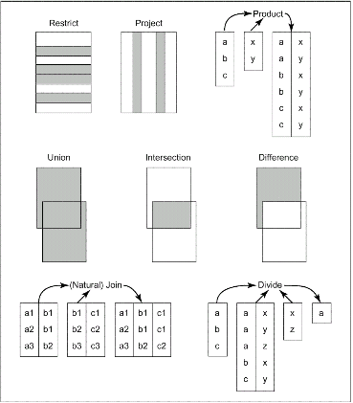
Fig. 6.1 The original eight operators (overview)

Slide 5
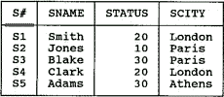
2. Closure property
Closure property:
  The output from any given relational operation is another relation.
  Nested relational expressions
RENAME operator:
  Rename attributes within a specified relation.
  e.g. S RENAME CITY AS SCITY

Slide 6
3. Semantics (关系操作的语义) -- Union
A
Two relations are type-compatible if they have the same set of attribute names which are defined on the same domains
B
The union of two (type-compatible) relations A and B:
A UNION B = {t|t∈A ∨ t∈B }
is a relation with the same heading as each of A and B and with a
body consisting of the set of all tuples t belonging to A or B or both.

Slide 7
Example of Union
Airport1
airport_name
country_name
Airport1 UNION Airport2
London/Gk
Naples
Pisa
England
Italy
Italy
airport_name
country_name
London/Gk
Naples
Pisa
London/Hw
Manchester
England
Italy
Italy
England
England
Airport2
airport_name
country_name
London/Gk
London/Hw
Manchester
England
England
England

Slide 8
3. Semantics-- Intersection
A
B
The intersection of two (type-compatible) relations A and B:
A INTERSECTION B = {t|t∈A ∧ t∈B }
- is a relation with the same heading as each of A and B and with a
body consisting of the set of all tuples t belonging to both A and B.

Slide 9
Example of Intersection
Airport1
airport_name
country_name
London/Gk
Naples
Pisa
England
Italy
Italy
Airport1 INTERSECTION Airport2
Airport2
airport_name
country_name
airport_name
country_name
London/Gk
England
London/Gk
London/Hw
Manchester
England
England
England

Slide 10
3. Semantics-- Difference
A
B
The difference of two (type-compatible) relations A and B in that order:
A MINUS B = {t|t∈A ∧ !t∈B }
- is a relation with the same heading as each of A and B and with a
body consisting of the set of all tuples t belonging to A and not to B.

Slide 11
Example of Difference
Airport1
airport_name
country_name
Airport1 MINUS Airport2
London/Gk
Naples
Pisa
England
Italy
Italy
airport_name
country_name
Naples
Pisa
Italy
Italy
Airport2
airport_name
country_name
London/Gk
London/Hw
Manchester
England
England
England
What about Airport2 MINUS Airport1?

Slide 12
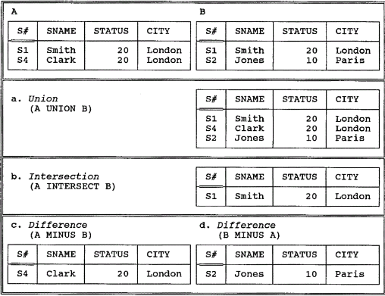
Example of Union/Intersection/Difference
Fig. 6.2 Union, intersection, and difference examples

Slide 13
3. Semantics - Product
b1
b2
a1 b1
a1 b2
a2 b1
a2 b2
a1
a2
TIMES
=
Let relations A and B have headings {X} and
{Y} respectively.
The Cartesian product of A and B where they have no common
attribute names:
A TIMES B = {ab|a∈A ∧ b∈B }
- is a relation with the heading that is the sum of the headings of A and
B and
body consisting of the set of all tuples t such that t is the
coalescing of a tuple a in A and a tuple b in B.
⌒

Slide 14
More about Product…
Semantics – Product…
The cardinality of the result of A TIMES B is the product of the cardinalities of A and B
The degree of the result is the sum of the degrees of A and B
The Cartesian product is not very important in practice
The result is often large and space-costly but produces no more information than there was in the input

Slide 15
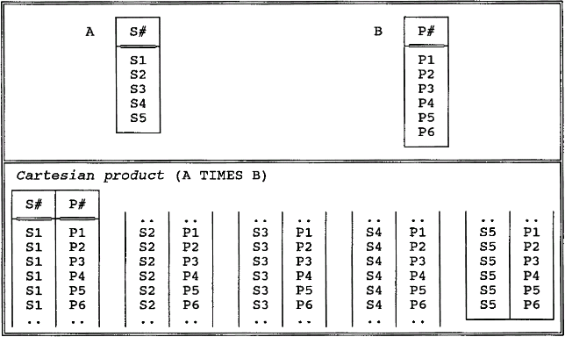
Example of Product…
    Fig. 6.3 Cartesian product example

Slide 16
3. Semantics - Restrict
A
The restriction of relation A on the condition:
A WHERE condition
is a relation with the same heading as A and with a
body consisting
of the set of all tuples t of A such that the condition is true for t

Slide 17
Restriction Condition
A WHERE X θ Y
X, Y are attributes of A, and must be defined on the same domain
θ is any simple scalar comparison operator like =, ≠, >, ≥ etc.
In fact, the restriction condition can be an arbitrary Boolean
combination of simple comparisons connected by AND, OR, NOT.
Take note: Unlike the traditional set operators, restrict takes a relation and an
expression as input, and produces a relation as output. Some concepts like
commutativity and associativity no longer applicable.

Slide 18
Example of Restrictions
Airports
Airports WHERE airport_name = ‘London/GK’
airport_name
country_name
airport_name
country_name
Naples
London/Gk
London/Hw
Pisa
Venice/MP
Manchester
Kai Tak
Changi
Italy
England
England
Italy
Italy
England
Hong Kong
Singapore
London/Gk
England
Airports WHERE country_name = ‘England’
airport_name
country_name
London/Gk
London/Hw
Manchester
England
England
England

Slide 19
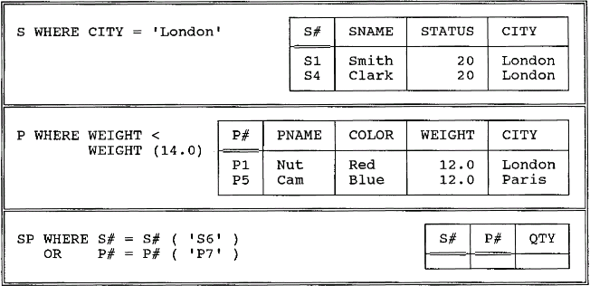
Example of Restrictions
Fig. 6.4 Restriction examples

Slide 20
3. Semantics - Project
A
The projection of relation A on attributes X, Y, …, Z:
A {X, Y, …, Z}
- is a relation with the heading {X, Y, …, Z} and with the a body
consisting of the set of all tuples {X:x, Y:y, …, Z:z} such that a
tuple appears in A with X-value x, Y-value y, …, Z-value z.

Slide 21
More about Projection
The projection operator produces the output table by 1) eliminating
all attributes not specified, and 2) eliminating any duplicated
tuples
A -- identity projection
A{} -- nullary projection (both not very useful but legal)
We may project some attributes away instead of the standard way
This operator can be used to 1) rename attributes, and 2) permute attributes

Slide 22
Example of Projections
Airports
Airports {country_name, airport_name}
airport_name
country_name
country_name
airport_name
Naples
London/Gk
London/Hw
Pisa
Venice/MP
Manchester
Kai Tak
Changi
Italy
England
England
Italy
Italy
England
Hong Kong
Singapore
England
London/Gk
… …
… …
Airports {country_name} a unary relation
country_name
(We could rename the attribute
at the same time using the below
expression:
Airport [RENAME country-name
AS country]
)
Italy
England
Hong Kong
Singapore

Slide 23
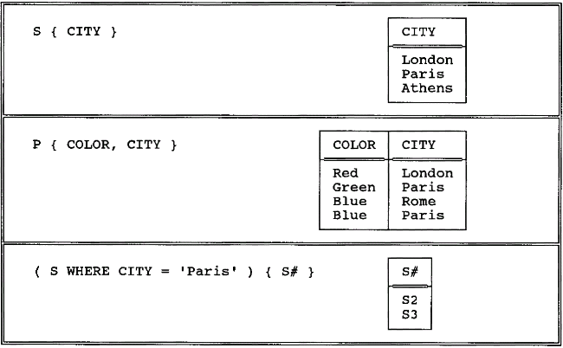
Example of project
Fig. 6.5 Projection examples

Slide 24
3. Semantics - Natural Join
b1 c1
b1 c2
a1 b1 c1
a1 b1 c2
a2 b1 c1
a2 b1 c2
a1 b1
a2 b1
join
=
Let relations A and B have headings {X, Y} and
{Y, Z} (where X, Y and Z are composite attributes).
The (natural) join of A and B: A JOIN B
- is a relation with the heading {X, Y, Z} and body consisting of the
set of all tuples {X:x, Y:y, Z:z} such that a tuple appears in A with
X-value x and Y-value y and a tuple appears in B with Y-value y and
Z-value z.

Slide 25
More about Natural Join
A JOIN B JOIN C = (A JOIN B) JOIN C
= A JOIN (B JOIN C) (associative)
A JOIN B = B JOIN A (commutative)
If A and B have no attribute names in common, A JOIN B = ?
= A TIMES B

Slide 26
Example of Natural Join
Airports
Stops
airport_name
country_name
flight_number
airport_name
stop_number
Naples
London/Gk
London/Hw
Pisa
Venice/MP
Manchester
Kai Tak
Changi
Italy
England
England
Italy
Italy
England
Hong Kong
Singapore
BA383
Kai Tak
1
BA019
Changi
2
Stops JOIN Airports
flight_number airport_name stop_number country_name
BA383 Kai Tak 1 Hong Kong
BA019 Changi 2 Singapore

Slide 27
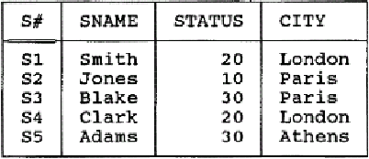
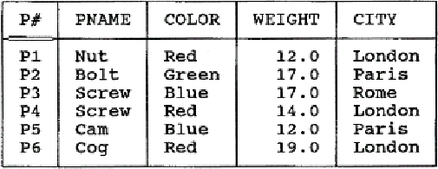
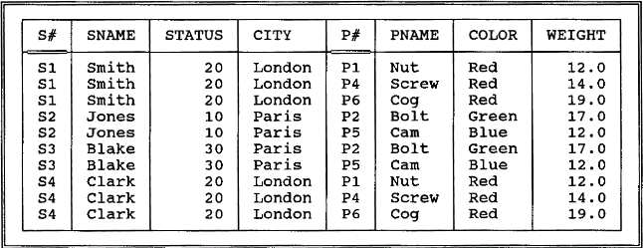
Example of Natural Join
S
P
Fig. 6.6 The natural join S JOIN P

Slide 28
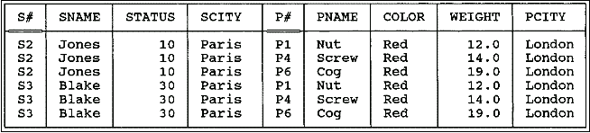
3. Semantics –θ-Join(θ连接）
A TIMES B WHERE RθS
e.g.
((S RENAME CITY AS SCITY) TIMES
(P RENAME CITY AS PCITY))
WHERE SCITY>PCITY
Fig. 6.7 Greater-than join of suppliers and parts on cities

Slide 29
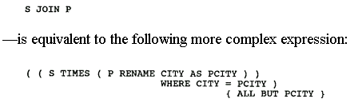
3. Semantics –equijoin(等值连接）
If θ is "=", the θ-join is called an equijoin.

Slide 30
3. Semantics –Divide
a x
a y
a z
b x
c y
=
a
b
c
divided by
x
y
per
a
The division of A by B per C:
A DIVIDEBY B PER C
Let relations A , B and C have headings
{X},{Y}, and {X, Y}
(where X and Y are composite attributes).
is a relation with the heading {X} and
body consisting of all tuples {X:x} such that a tuple {X:x, Y:y} appears in C for all tuples
{Y:y} appearing in B.

Slide 31
Example of Division
Suppose that we wish to know airports to which we
can fly from both London/Gk and London/Hw
Airports
destination
Airport_London
destination
origin
Destin
London/Gk
Pisa
Manchester
Kai Tak
London/Hw
DIVIDEBY
origin
London/Gk
Pisa
Pisa
London/Gk
Manchester
Kai Tak
Manchester
London/Hw
Naples
London/Gk
London/Hw
Pisa
Venice/MP
Manchester
Kai Tak
Changi
destination
PER
=
London/Gk
Pisa
London/Hw
‘Both’ , ‘All’ etc. hint the division operator:
ex. Get suppliers who supply all parts

Slide 32
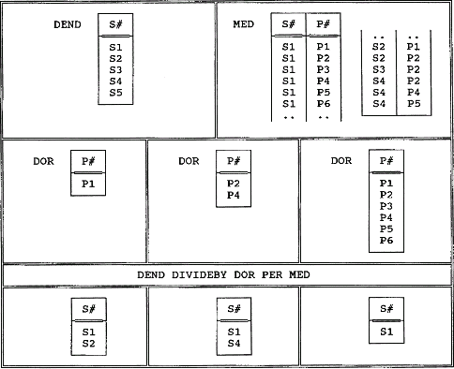
Example of Division
A DIVIDEBY B PER C
Fig. 6.8 Division examples

Slide 33
3. Semantics – Associativity and Commutativity
结合律和交换律
A UNION B UNION C = (A UNION B) UNION C
= A UNION (B UNION C) (associative)
(Applicable to INTERSECT and TIMES but not to MINUS)
A UNION B = B UNION A (commutative)
(Applicable to INTERSECT and TIMES but not to MINUS)
Note that the Cartesian product operation of set theory is neither associative nor commutative, but the relational version as we have defined it IS both.

Slide 34
Note:
Some of Godd eight operators are not primitive
{restrict, project, product, union, difference}-→minimal set

Slide 35
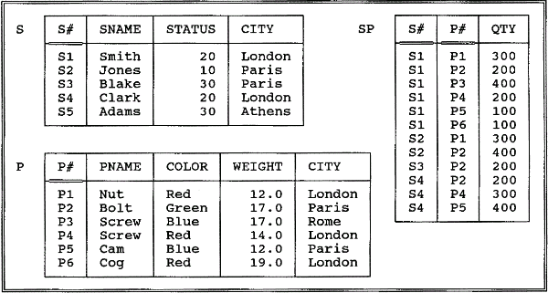
4. Examples
Fig. 3.8. The Suppliers and parts database(sample values)
P111

Slide 36
4. Examples
Get supplier names for suppliers who supply part P2.
Get supplier names for suppliers who supply at least one red part.

Slide 37

4. Examples…
Get supplier names for suppliers who supply all parts.
Get supplier numbers for suppliers who supply at least all those parts supplied by supplier S2.
Get all pairs of supplier numbers such that the two suppliers concerned are "colocated" (i.e., located in the same city).

Slide 38
4. Examples…
Get supplier names for suppliers who do not supply part P2.

Slide 39
5. What is the Algebra for?
The fundamental intent of the algebra is to allow the writing of the relational expressions.
Defining a scope for retrieval
Defining a scope for update
Defining integrity constraint
Defining derived relvars
Defining stability requirements
Defining security constraints

Slide 40
5. What is the Algebra for?...
serve as a convenient basis for optimization
the expressions serving as a high-level, symbolic representation of the user’s intent, can be transformed into the logically equivalent.
((SP JOIN S ) WHERE P#=P#(‘P2’)){SNAME}
=
((SP WHERE P#=P#(‘P2’) JOIN S ){SNAME}
yardstick to measure the expressive power of some given language.
relational compete

Slide 41
课堂练习
Student
学号 | 姓名 | 性别 | 年龄 | 系
00301 00302 00303 00304 | 李勇 刘晨 王明 张力 | 男 女 女 男 | 20 19 18 19 | CS IS MA IS
Course
课程号 | 课程名 | 先行课 | 学分
1 2 3 4 5 6 7 | 数据库 数学 信息系统 操作系统 数据结构 数据处理 C语言 | 5 1 6 7 6 | 4 2 4 3 4 2 1
SC
学号 | 课程号 | 成绩
00301 00301 00301 00302 00302 | 1 2 3 2 3 | 92 85 88 90 80

Slide 42
课堂练习
求解：
1. 所有学生的姓名、性别；
2. 信息系学生的姓名、性别；
3. 选修了“数学”课的学生姓名、性别；
4. 同时选修了“数学”和“信息系统”课的学生姓名；
5. 至少选修了课程1、3的学生学号；
6. 上例中的学生学号、姓名、系；
7. 选修了课程2的学生学号；
8. 至少选修了一门其直接先行课为6的课程的学生姓名；
9. 选修了全部先行课为6的课程的学生姓名；
10. 选修了“刘晨”所选全部课程的学生姓名；
11. 年龄最大(or 成绩最高)的学生姓名；
12. 与“刘晨”同系的学生姓名；
13. 同系学生对。

